Slide 1

CONNEXION
Connects you with work

Slide 2


Mentor
Smt. P.Vijaya Kumari Madam _{M.Tech.,(Ph.D)}
Assistant professor(Adhoc)
Department of CSE
JNTUA college of Engineering, Pulivendula
Team Members
20191A0511 U Shamitha
20191A0521 P Misbah Khanam
20191A0552 R Balaji Naik
20191A0561 B Venkata Subba Reddy

Slide 3



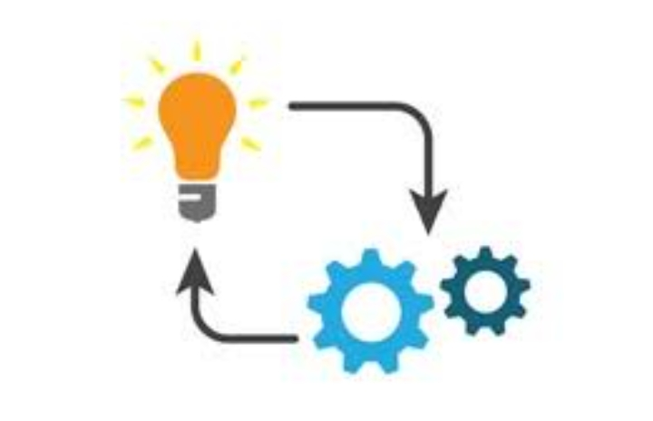

OUTLINE
1
Problem statement
2
Way of approach
3
How is it socially relevant
4
Implementation
5
Technologies

Slide 4
problem statement

Slide 5

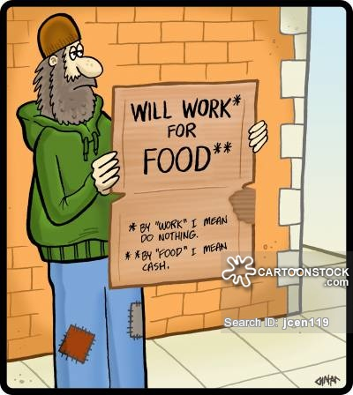
PROBLEMS ADDRESSED
Labor Shortage
Lack of work

Slide 6
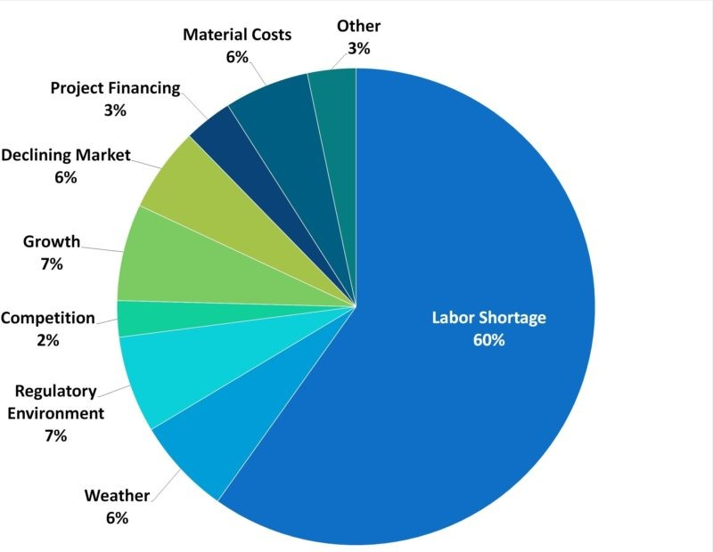
INDUSTRY CRISIS
This pie chart shows challenges faced in completion of work in time.
It shows that all other factors effect only 40% while only labour shortage has an effect of 60%.

Slide 7
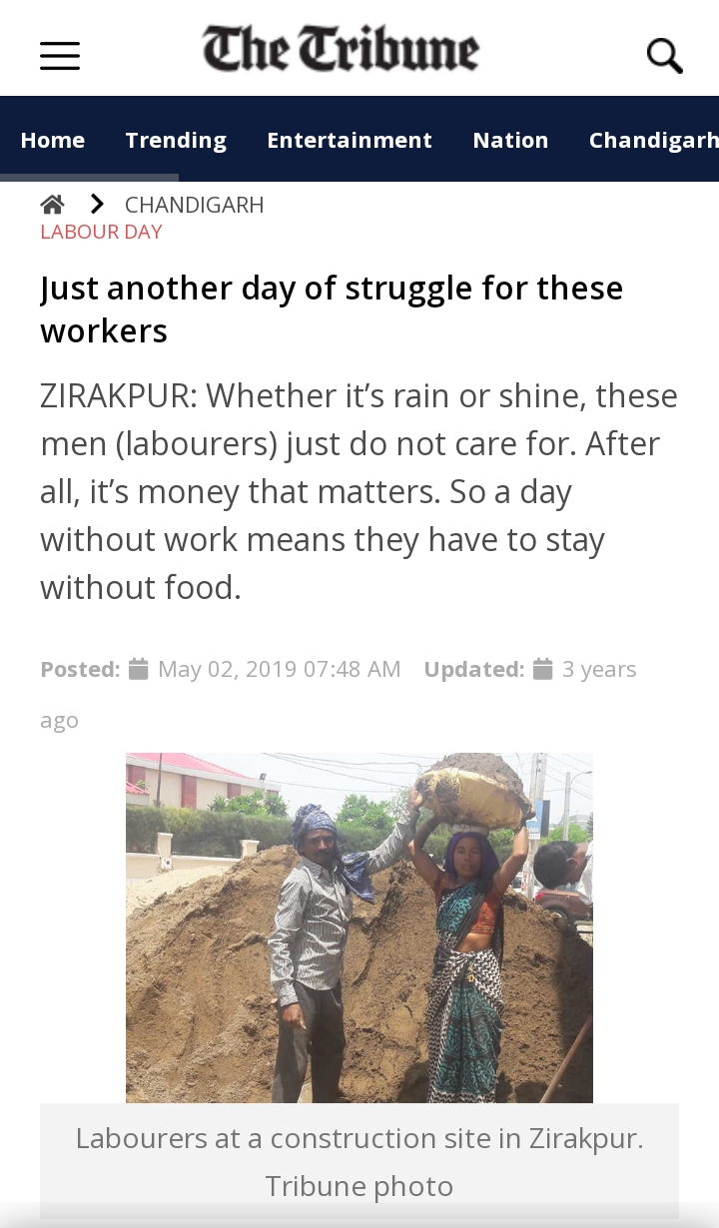
LACK OF WORK
An article depicting the struggle of daily wage workers.
It shows that for these workers
“NO WORK
NO PAY
NO RICE”

Slide 8
Way of approach

Slide 9

SOLUTION
WE CONNECT THE WORKERS WITH WORK PROVIDERS
Our Solution for this problem statement is mobile application that connects the workers who are in need of work with the work providers who are in need of workers

Slide 10
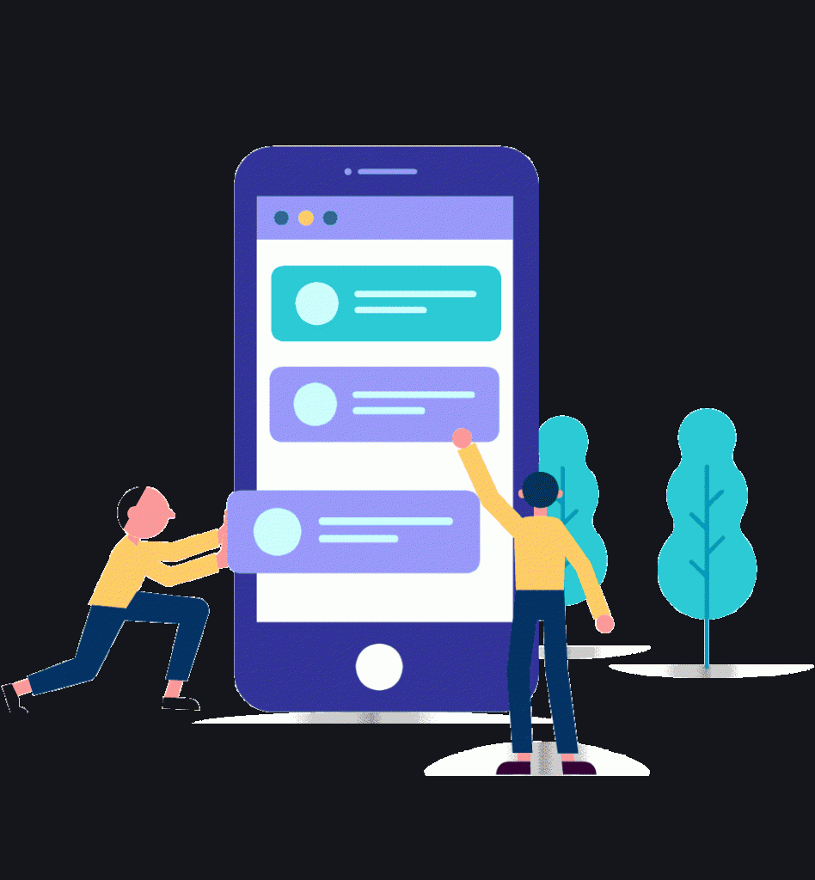

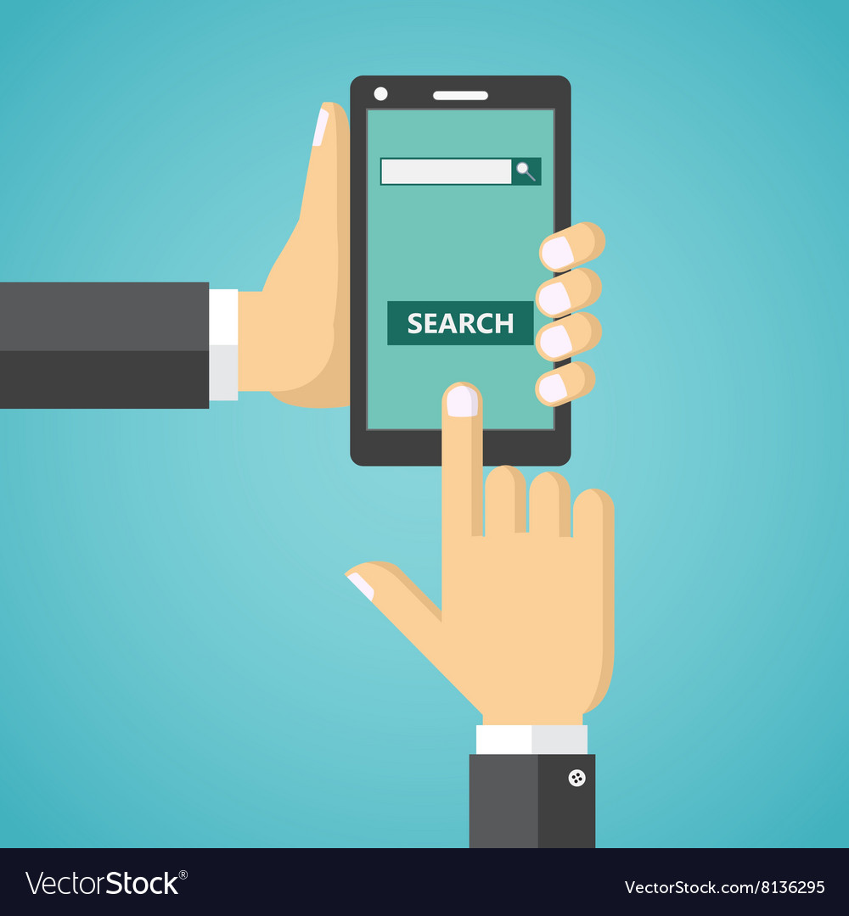



Features
We want to build our app in such a way that we include the following features
2
3
name
location
register
WORK SEEKER
WORK PROVIDER
Post a work announcement
by Work provider
Register as worker
Search for worker or work provider

Slide 11
How is it socially relevant

Slide 12


Main problems are solved
contact

Slide 13


Advertisements

Slide 14


Provide better work and skilled worker

Slide 15
OUTCOMES
Works will complete on time
People who can’t find work
Increases work opportunities
To find workers for household works
Decreases difficulty in finding workers of different sectors
Women who want
To work at home
Connexion

Slide 16
Implementation

Slide 17
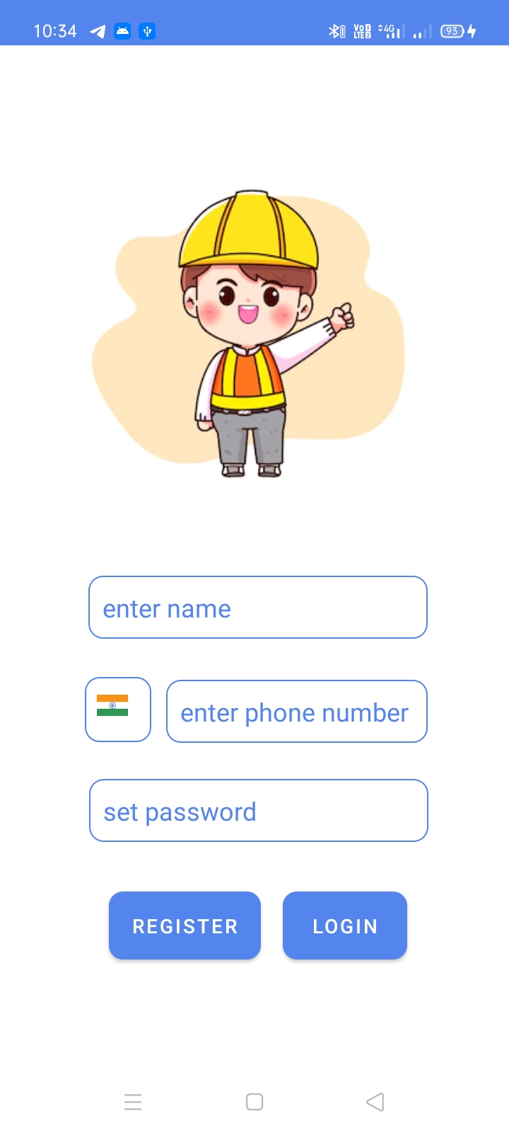
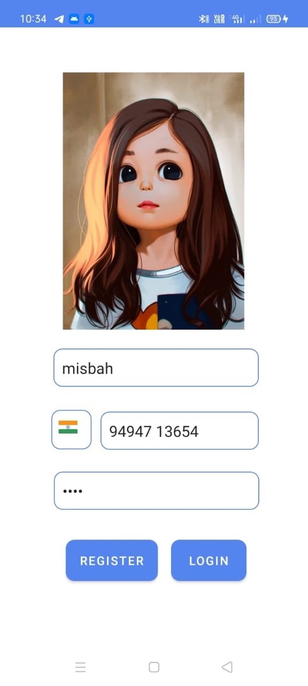
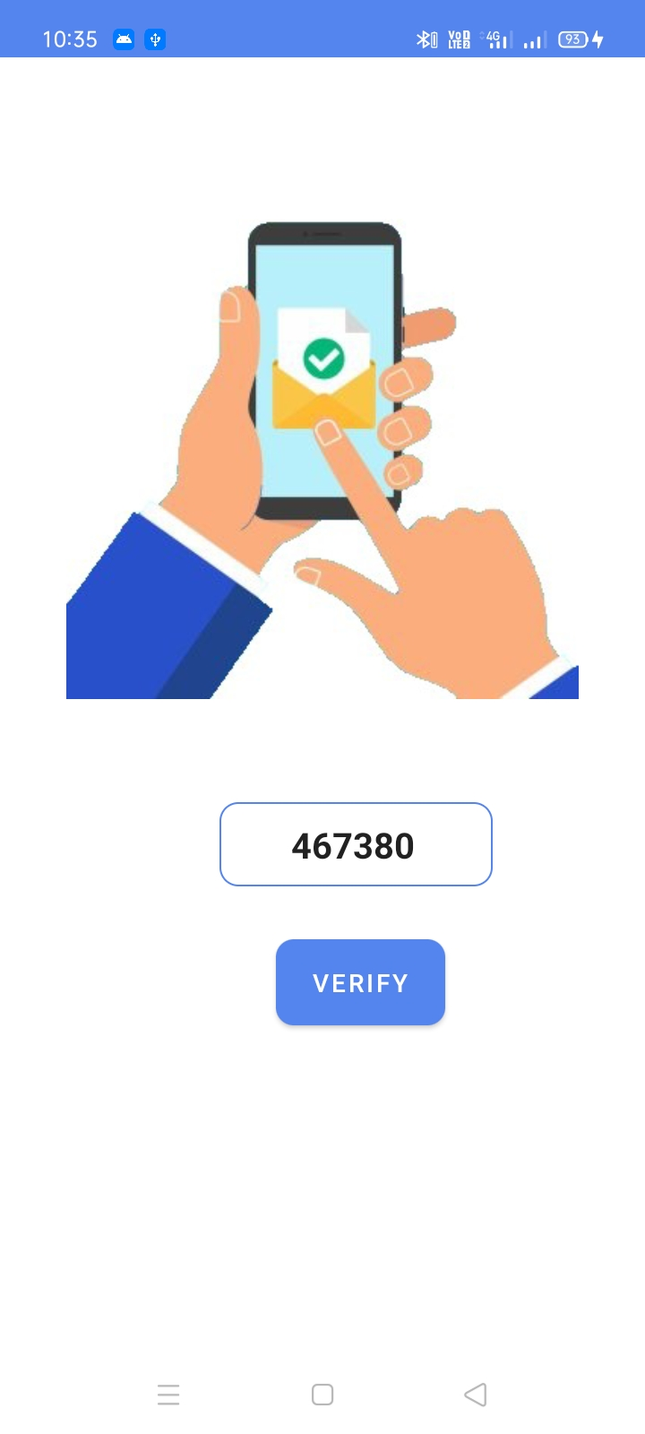
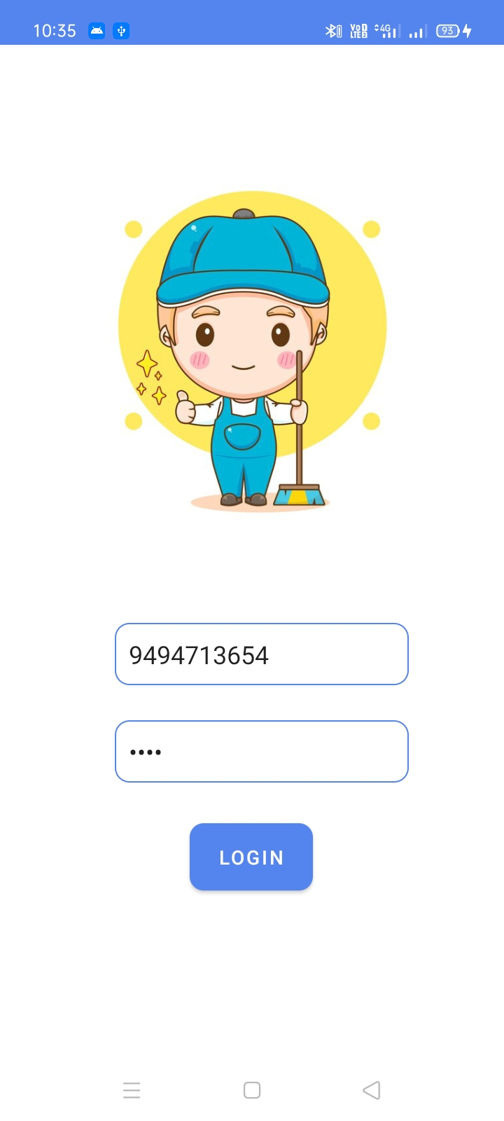
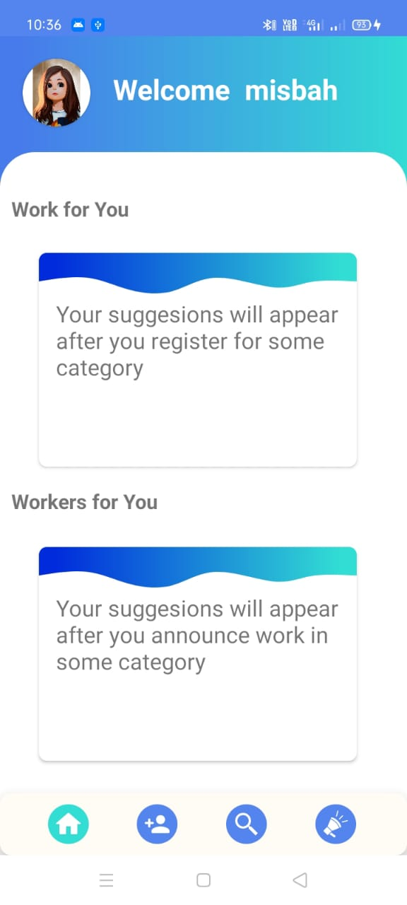
USER REGISTRATION AND LOGIN
User registration screen
Enter your details
Enter OTP
Enter login credentials
Your Home page

Slide 18
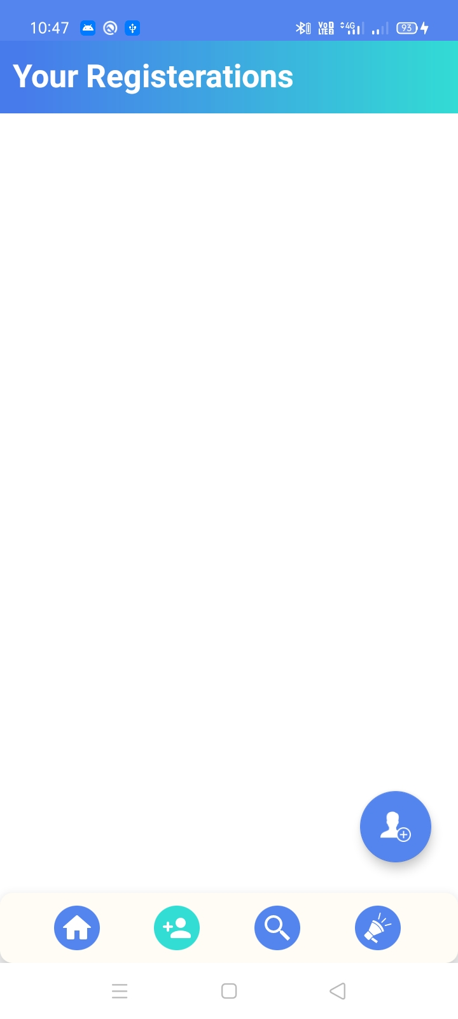
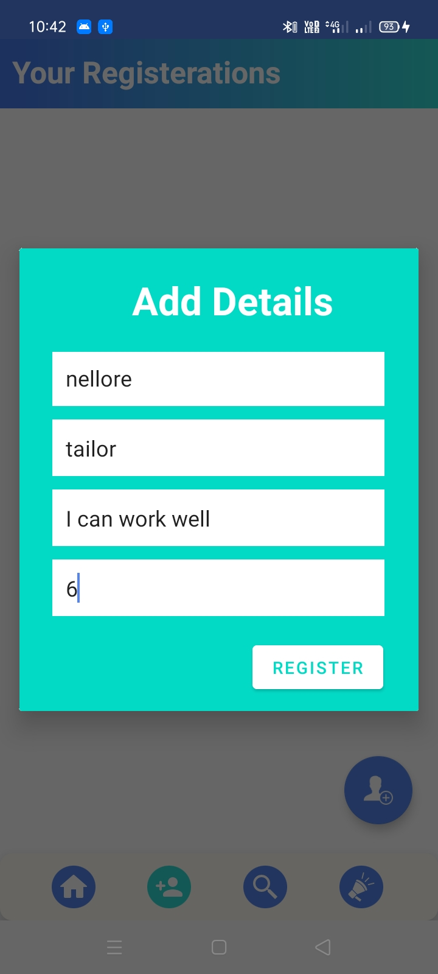
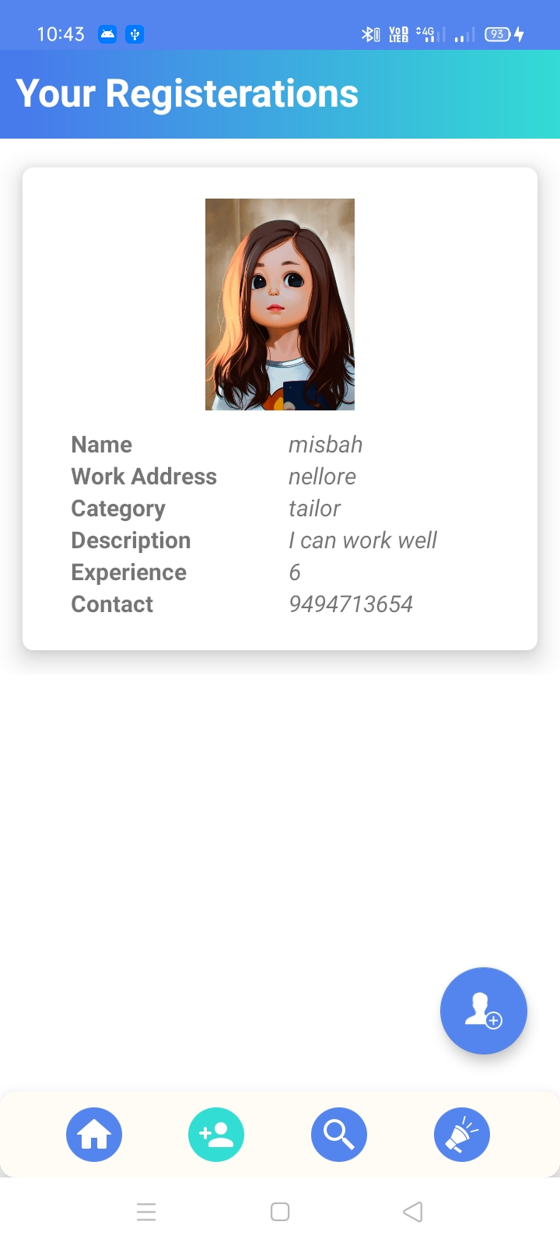
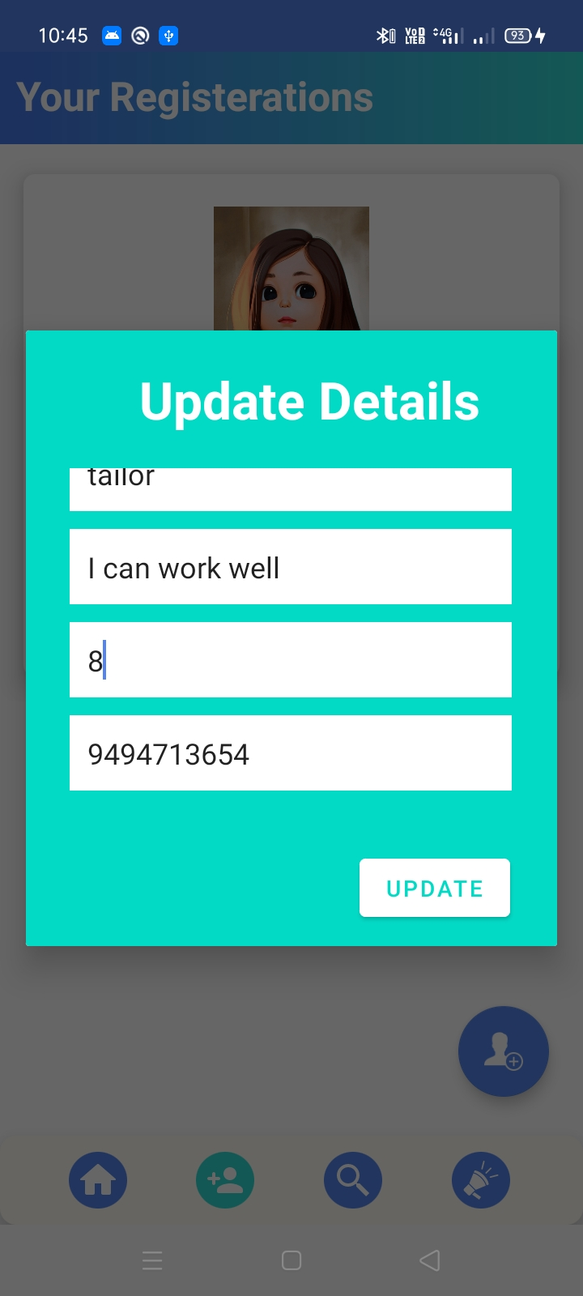

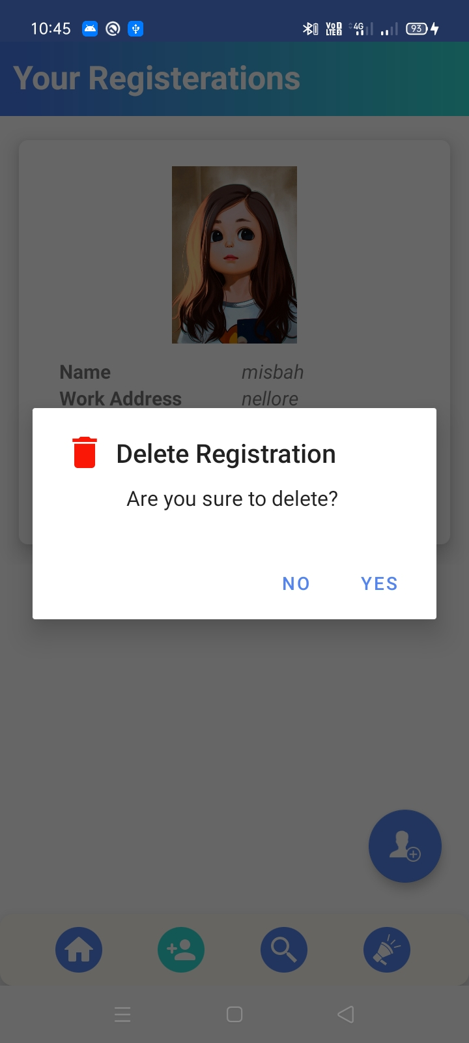
REGISTRATION SCREEN
Initial view
Register as new worker
Update your registrations
Delete registration

Slide 19
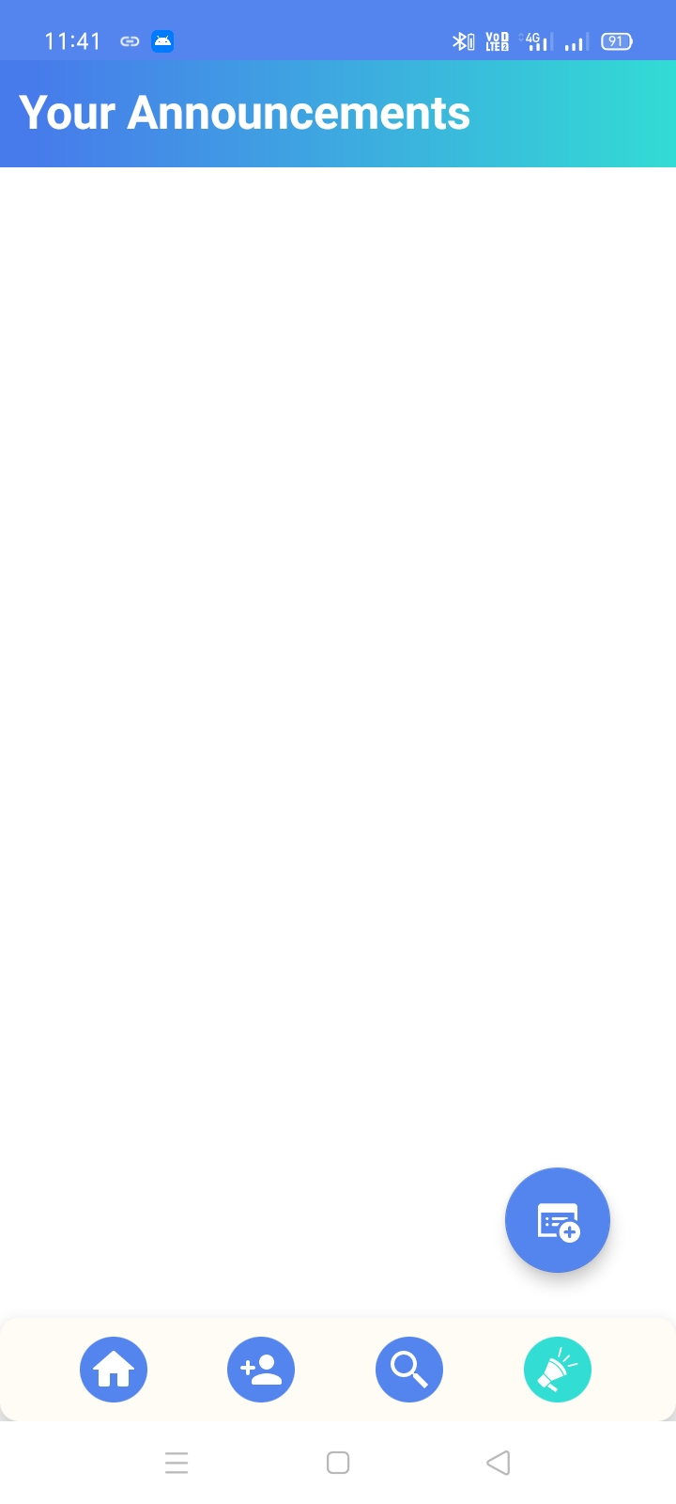
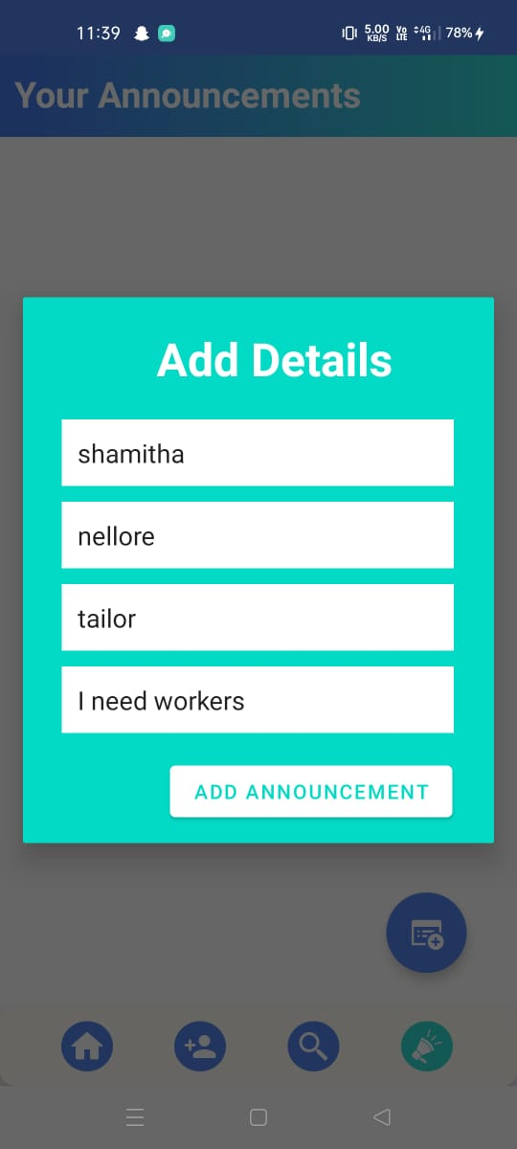
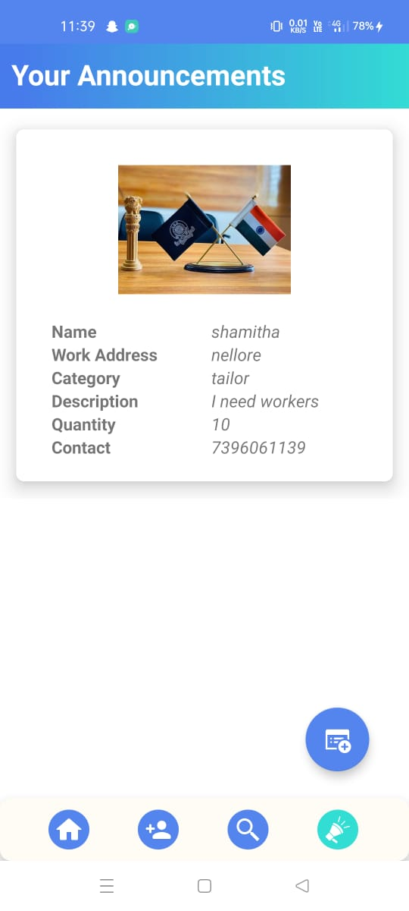
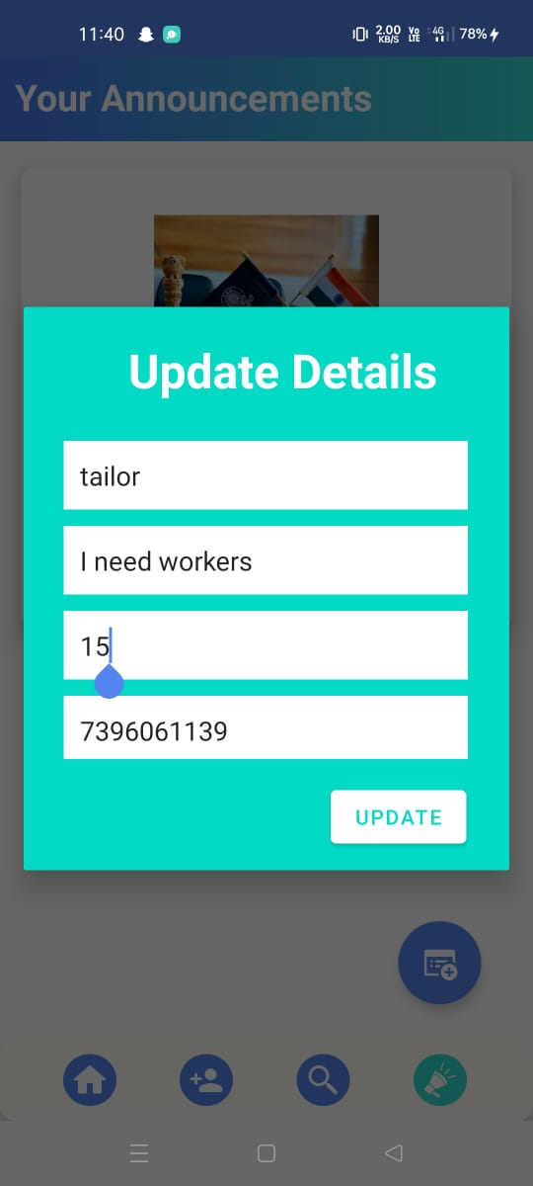

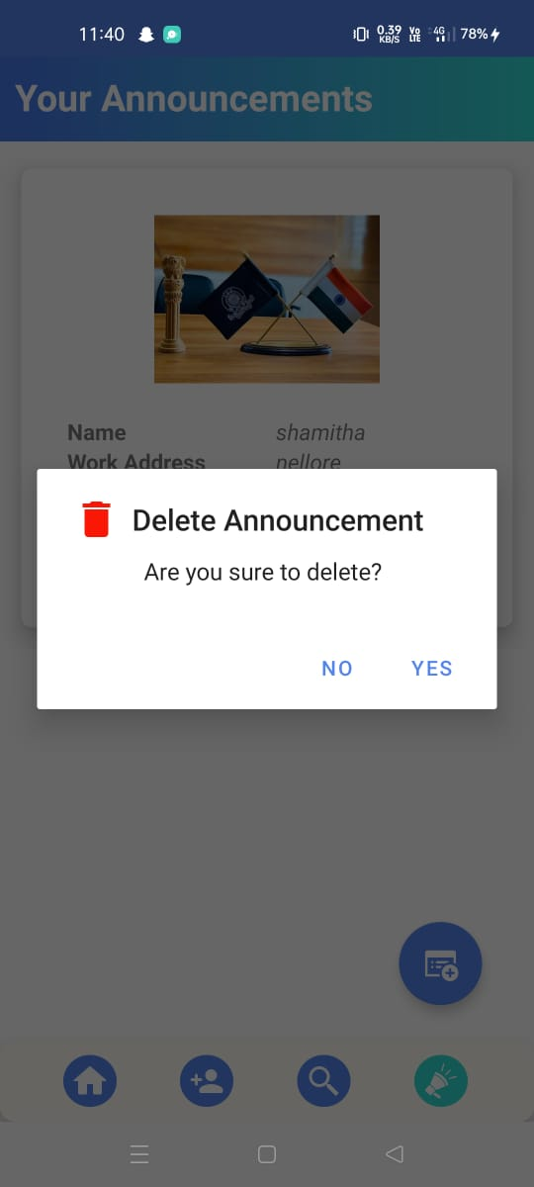
ANNOUNCEMENT SCREEN
Announcements screen
Announce new work
Update your announcements
Delete announcement

Slide 20
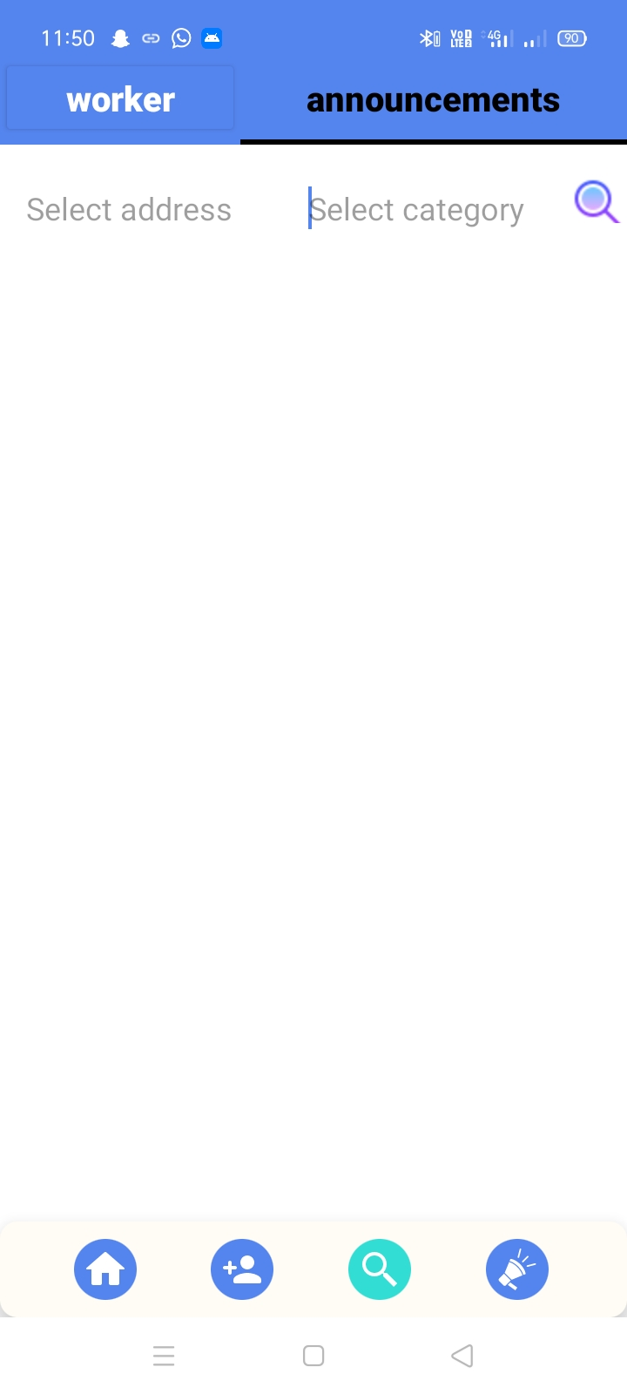
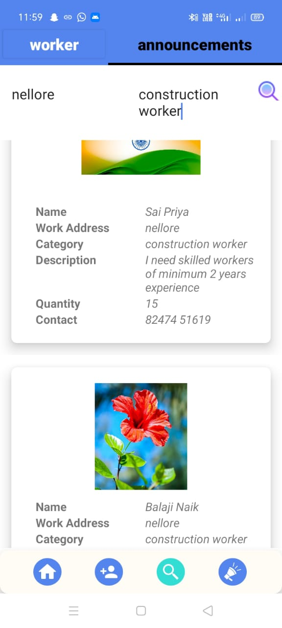
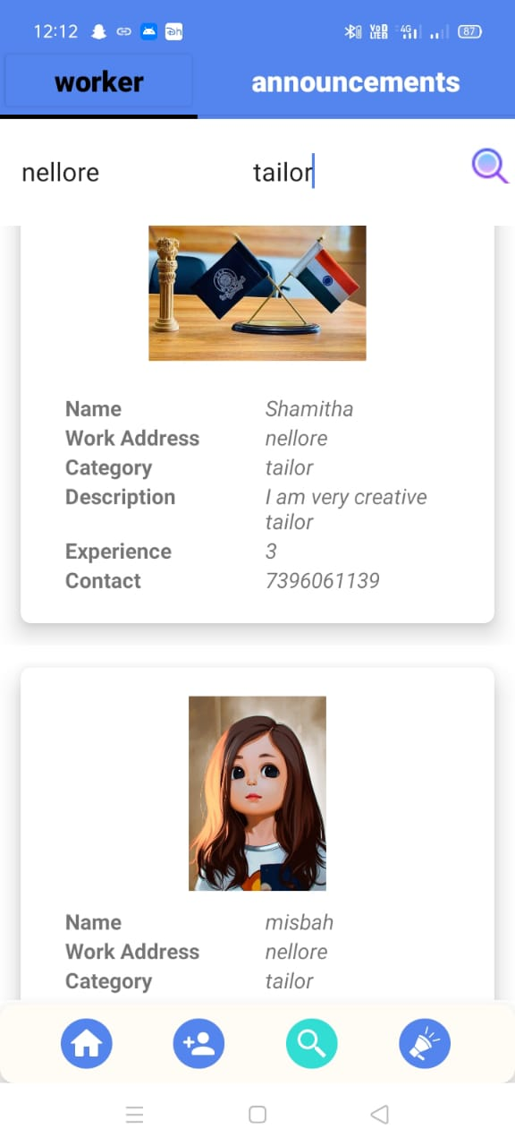

SEARCH SCREEN

Slide 21
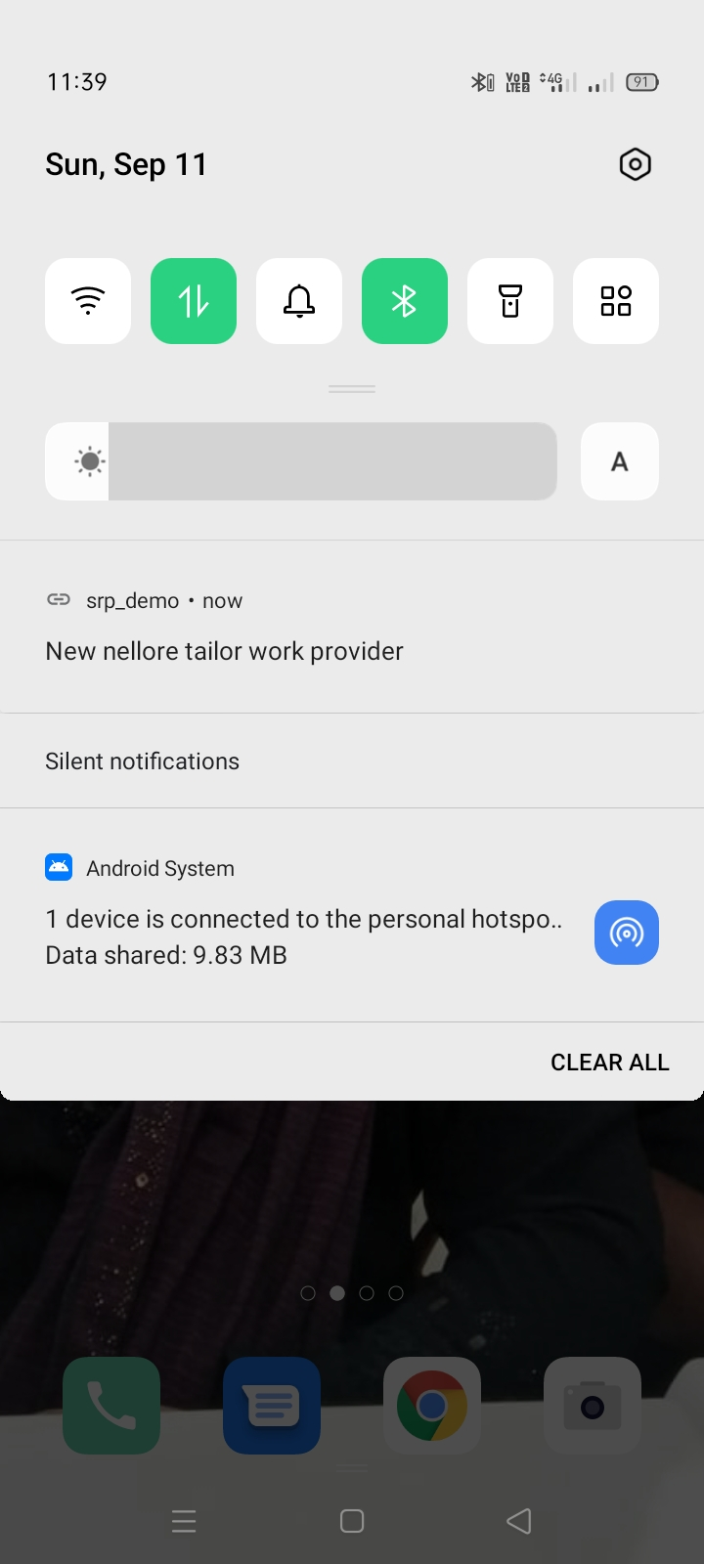
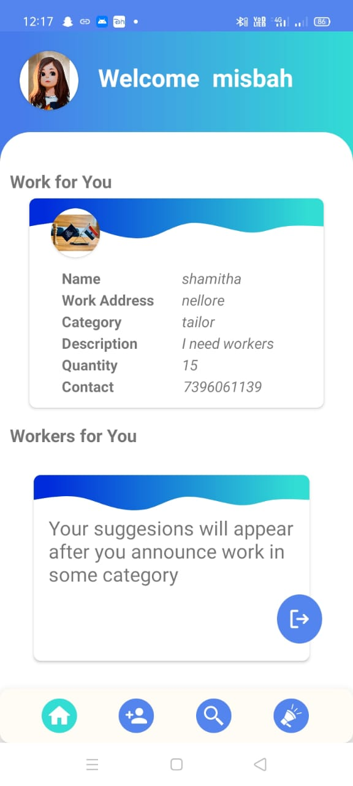
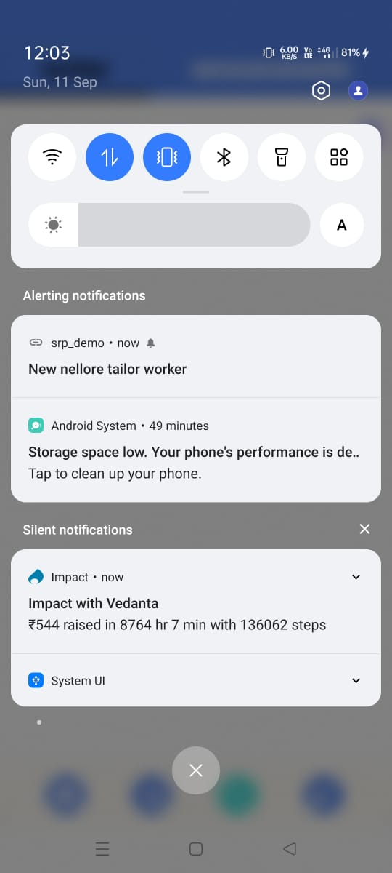
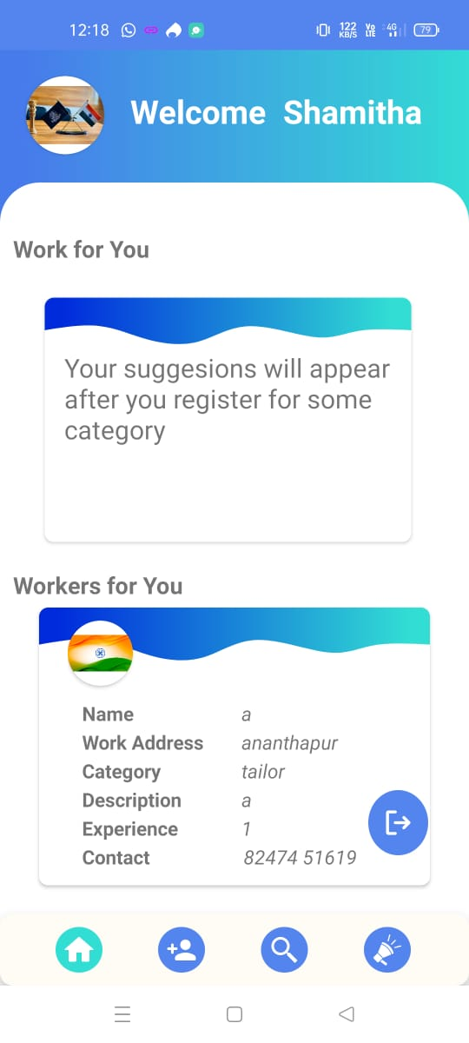
NOTIFICATIONS AND SUGGESTIONS

Slide 22
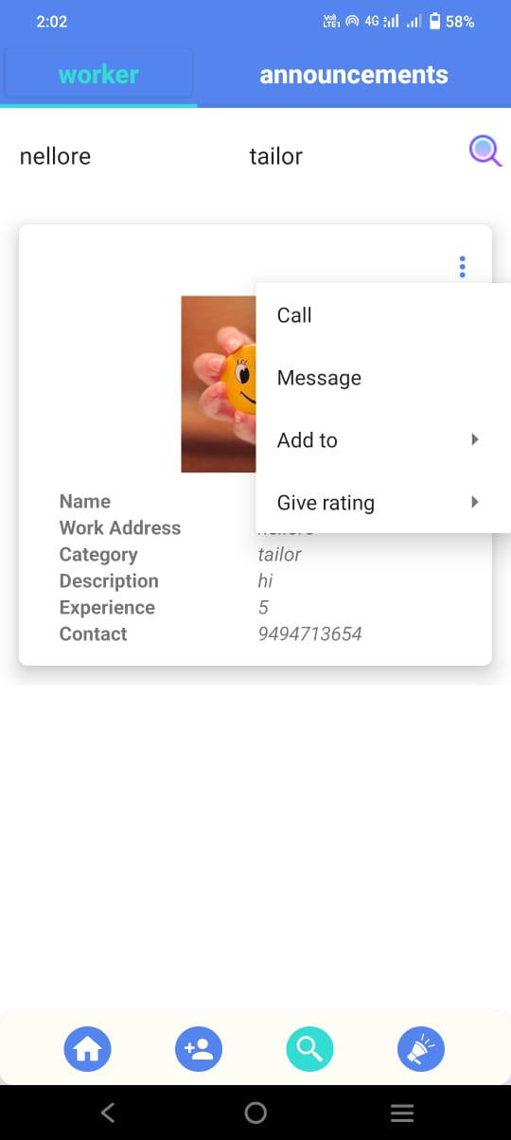
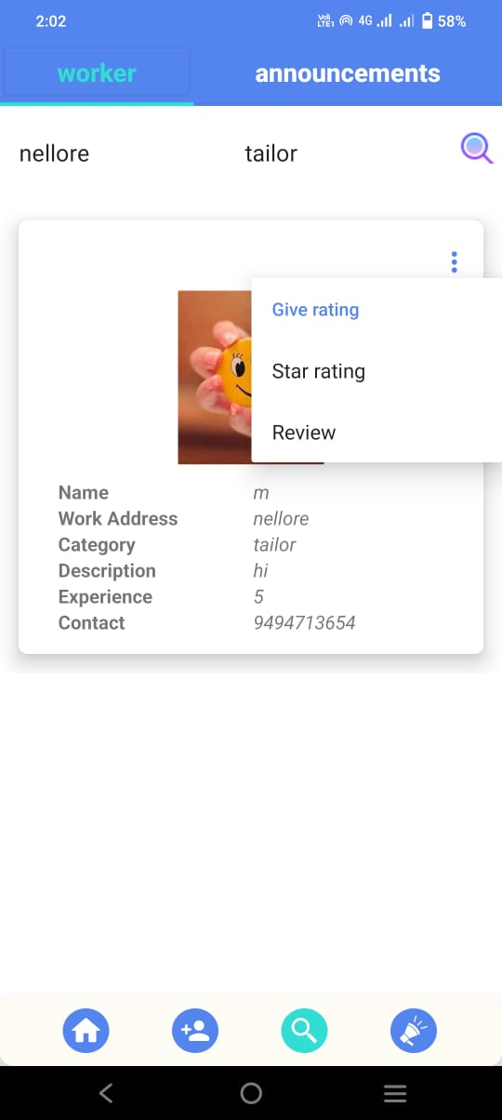
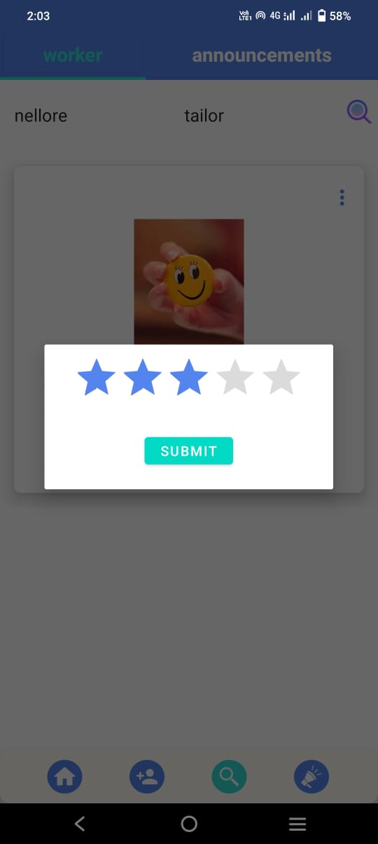
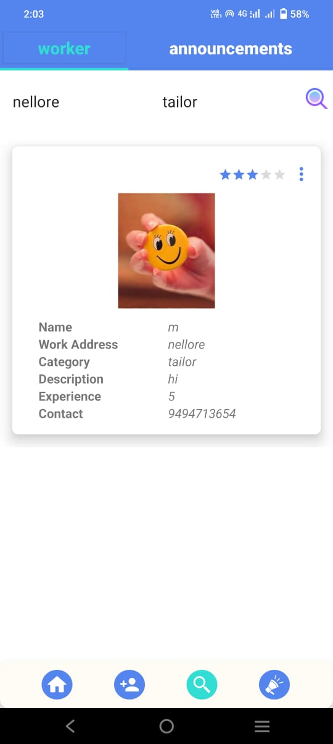
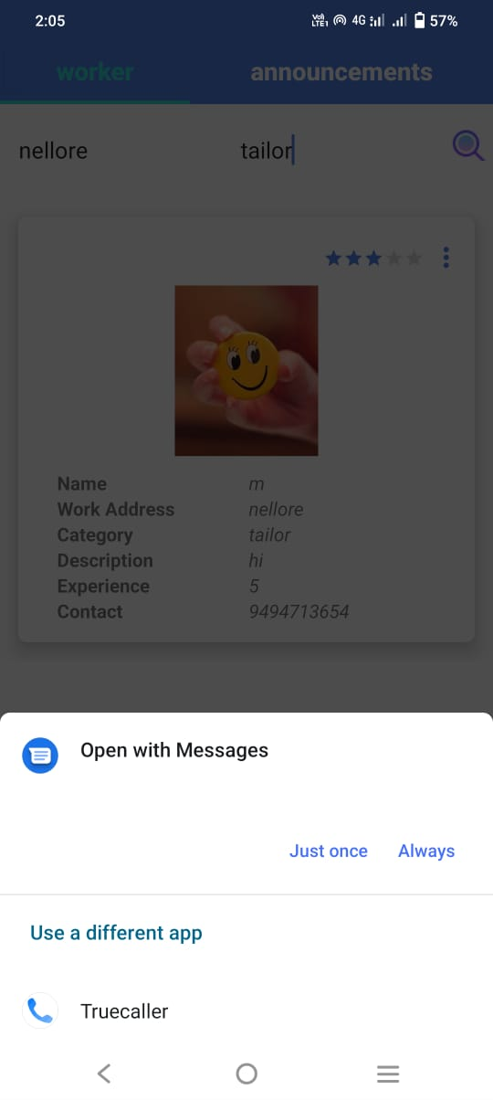
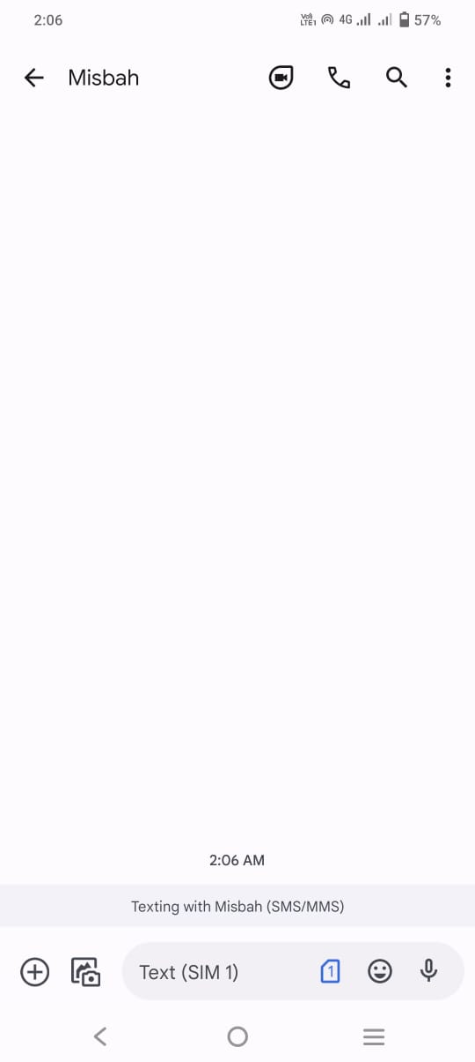
MENU OPTIONS
Options
Give Rating
Message

Slide 23

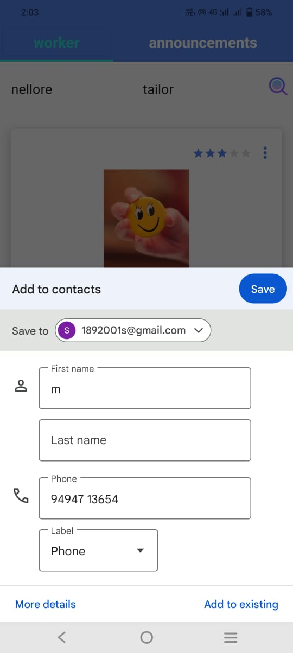
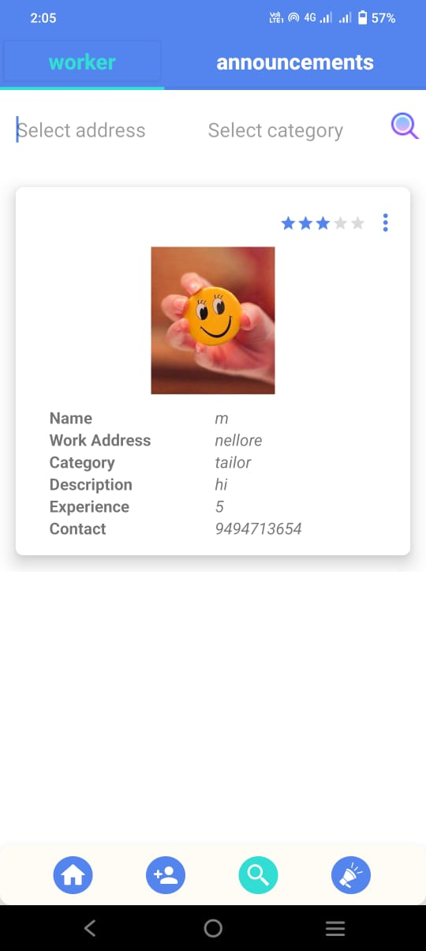
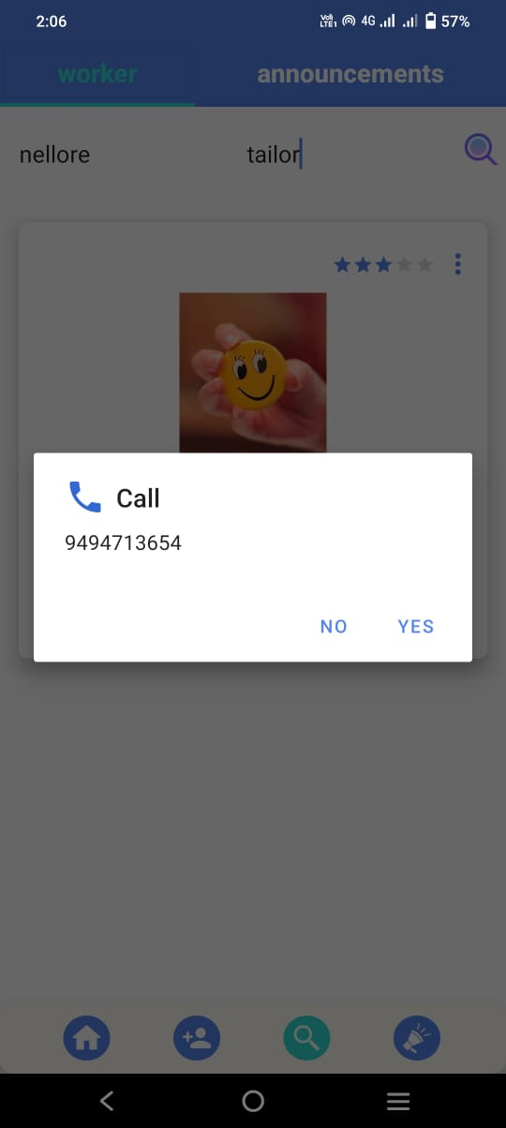
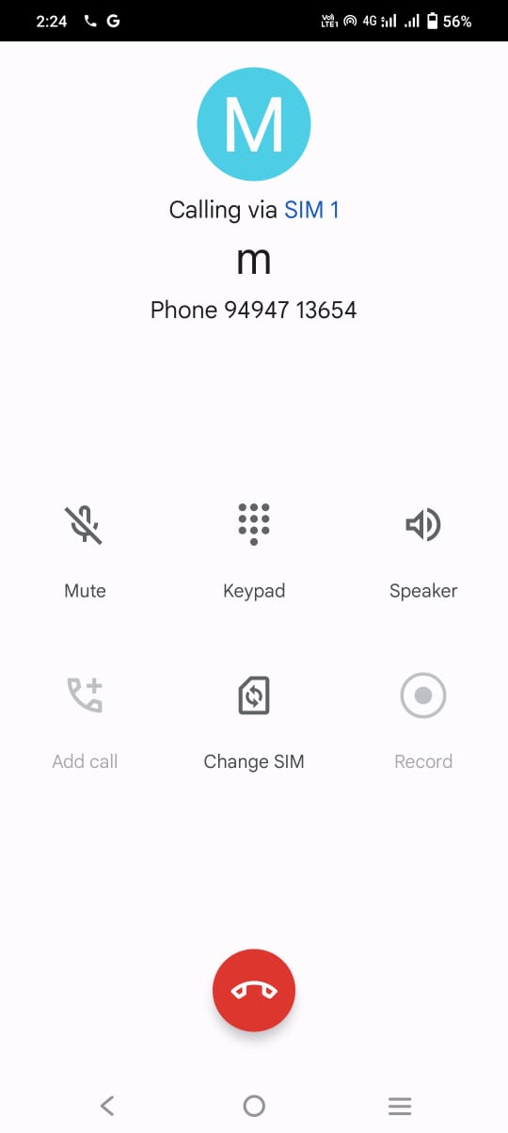
MENU OPTIONS
Add to: Contacts Favourites
Call

Slide 24
Tools and Technologies

Slide 25






Tools and Technologies that we used till now…….
Android Studio
Java
Firebase
Realtime Database
Authentication
Storage

Slide 26
Thank You

